Slide 1
Engine Room Simulator Prepare ER for departure 2-MHBO

Slide 2
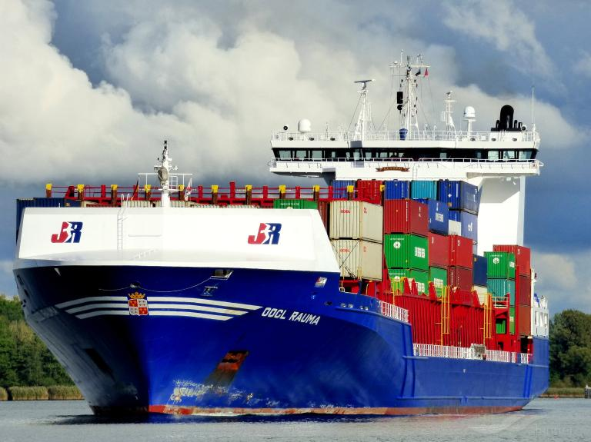
POSITION MOORED SCHEDULED DEPARTURE 1500H CONTACT BRIDGE FOR MORE DEPARTURE INFORMATION CARGO OPERATIONS CONTRACT BRIDGE FOR FURTHER INFORMATION BUNKER OPERATIONS FUEL OIL FINISHED / DISCONNECTED LUBRIOCATION OIL FINISHED / DISCONNECTED WATER SCHEDULED
GENERAL CONDITIONS VESSEL

Slide 3
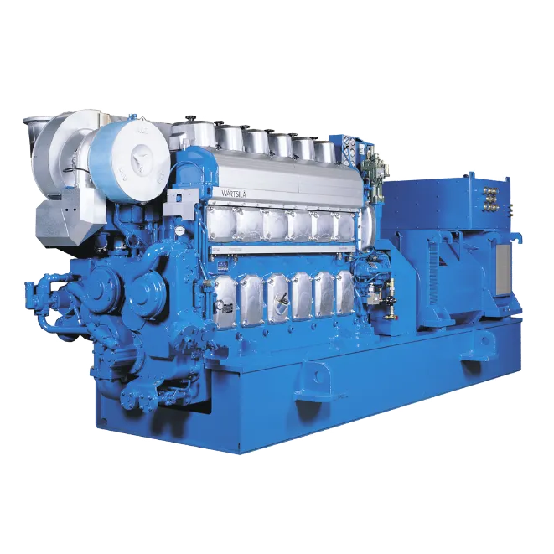
DIESEL GENERATOR 1 ONLINE DIESEL GENERATOR 2 MAINTENANCE SHAFT GENERATOR STAND-BY EMDG STAND-BY START AIR COMPRESSOR 1 ON 2 OFF SERVIVE AIR COMPRESSOR 1 ON HYDROFORE SYSTEM ON REFRIGERATION SYSTEM ON
Status Engine Room
STATUS ENGINE ROOM
DIESEL GENERATOR 1 ONLINE DIESEL GENERATOR 2 MAINTENANCE SHAFT GENERATOR STAND-BY EMDG STAND-BY
BOILER OFF START AIR COMPRESSOR 1 ON 2 OFF SERVIVE AIR COMPRESSOR 1 ON HYDROFORE SYSTEM ON REFRIGERATION SYSTEM ON
MAIN ENGINE
COOLING SYSTEMS OFF
FUEL SYSTEMS OFF
PURIFIERS OFF
LUBRICATION SYSTEMS OFF
PURIFIER OFF

Slide 4
DIESEL GENERATOR 1 ONLINE DIESEL GENERATOR 2 MAINTENANCE SHAFT GENERATOR STAND-BY EMDG STAND-BY START AIR COMPRESSOR 1 ON 2 OFF SERVIVE AIR COMPRESSOR 1 ON HYDROFORE SYSTEM ON REFRIGERATION SYSTEM ON
Status Engine Room
DEPARTURE CHECKLIST
ELECTRICAL POWER
GENERATORS Ο
POWER DISTRIBUTION Ο
BOW THRUSTER Ο
DECK MACHINERY Ο
MAIN ENGINE
COOLING WATER SYSTEM Ο
FUEL OIL SYSTEM Ο
LUBRICATION OIL SYSTEMS Ο
STEAM SYSTEM
TURNING GEAR Ο
STARTING AIR Ο
VENTILATION Ο
AIR CONDITIONING Ο
STEERING GEAR Ο

Slide 5
DIESEL GENERATOR 1 ONLINE DIESEL GENERATOR 2 MAINTENANCE SHAFT GENERATOR STAND-BY EMDG STAND-BY START AIR COMPRESSOR 1 ON 2 OFF SERVIVE AIR COMPRESSOR 1 ON HYDROFORE SYSTEM ON REFRIGERATION SYSTEM ON
Status Engine Room
EXAMPLE: DEPARTURE CHECKLIST
ELECTRICAL POWER
GENERATORS Ο
POWER DISTRIBUTION Ο
BOW THRUSTER Ο
DECK MACHINERY Ο
MAIN ENGINE
COOLING WATER SYSTEM Ο
FUEL OIL SYSTEM Ο
LUBRICATION OIL SYSTEMS Ο
TURNING GEAR Ο
STARTING AIR Ο
VENTILATION Ο
AIR CONDITIONING Ο
STEERING GEAR Ο

